Slide 1

Lecture Presentation
Chapter 17 Additional Aspects of Aqueous Equilibria
James F. Kirby
Quinnipiac University
Hamden, CT
© 2015 Pearson Education, Inc.

Slide 2
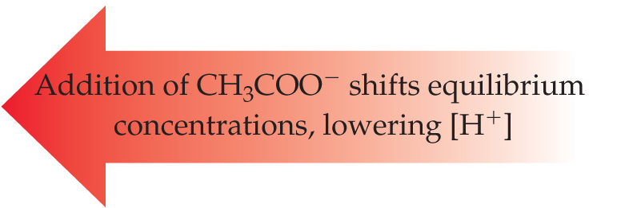
Effect of Acetate on the Acetic Acid Equilibrium
Acetic acid is a weak acid:
CH₃COOH(aq) ⇌ H⁺(aq) + CH₃COO–(aq)
Sodium acetate is a strong electrolyte:
NaCH₃COO(aq) → Na⁺(aq) + CH₃COO–(aq)
The presence of acetate from sodium acetate in an acetic acid solution will shift the equilibrium, according to LeChâtelier’s Principle:
CH₃COOH(aq) ⇌ H⁺(aq) + CH₃COO–(aq)

Slide 3
The Common-Ion Effect
“Whenever a weak electrolyte and a strong electrolyte containing a common ion are together in solution, the weak electrolyte ionizes less than it would if it were alone in solution.”
This affects acid–base equilibria.
We will also see (later in the chapter) how it affects solubility.

Slide 4
Calculate the pH of a 0.30 M solution of acetic acid, CH₃COOH, at 25 °C.
CH₃COOH + H₂O ⇌ H₃O⁺ + CH₃COO–
K_{a} = [H₃O⁺][CH₃COO–] / [CH₃COOH]
 | CH₃COOH (M) | H₃O⁺ (M) | CH₃COO– (M)
Initial Concentration (M) | 0.30 | 0 | 0
Change in Concentration (M) | –x | +x | +x
Equilibrium Concentration (M) | 0.30 – x | x | x

Slide 5
K_{a} = [H₃O⁺][CH₃COO–] / [CH₃COOH]
= (x)(x) / (0.30 – x)
If we assume that x << 0.30 (if smaller than 5% or 1/20), then (0.30 – x) ≈ 0.30. The problem becomes easier, since we don’t have to use the quadratic formula to solve it.
K_{a} = 1.8 × 10^{–5} = x² / 0.30
so x = 2.3 × 10^{–3} (indeed, x << 0.30)
x = [H₃O⁺], so pH = –log(2.3 × 10^{–3}) = 2.64

Slide 6
An Acid–Base Example
What is the pH of a solution made by adding 0.30 mol of acetic acid and 0.30 mol of sodium acetate to enough water to make 1.0 L of solution?
CH₃COOH(aq) ⇌ H⁺(aq) + CH₃COO–(aq)
K_{a} = [H⁺][CH₃COO–]/[CH₃COOH] = 1.8 × 10^{–5}
 | [CH₃COOH] (M ) | [H⁺] (M) | [CH₃COO–] (M)
Initial Concentration (M) | 0.30 | 0 | 0.30
Change in Concentration (M) | –x | +x | +x
Equilibrium Concentration (M) | 0.30 – x | x | 0.30 + x

Slide 7
1.8 × 10^{–5} = (x)(0.30 + x)/(0.30 – x)
Assume that adding or subtracting x from 0.30 will not change 0.30 enough to matter and the equation becomes
[CH₃COO–] / [CH₃COOH] = [CH₃COO–]₀ / [CH₃COOH]₀
1.8 × 10^{–5} = (x)(0.30)/(0.30)
which results in: x = 1.8 × 10^{–5} = [H⁺]
So: pH = –log[H⁺] = 4.74

Slide 8
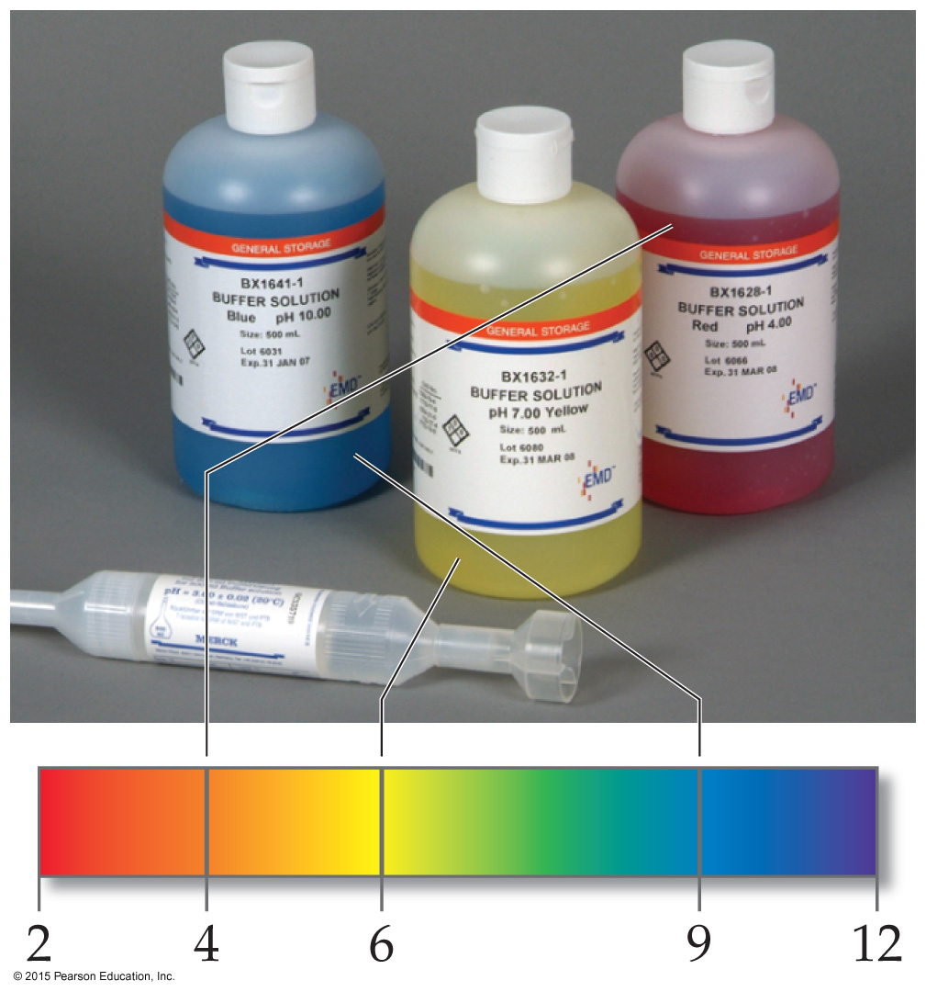
Buffers
Solutions of a weak conjugate acid–base pair that resist drastic changes in pH are called buffers.
These solutions contain relatively high concentrations (10^{–3} M or more) of both the acid and base. Their concentrations are approximately equal.

Slide 9
Ways to Make a Buffer
Mix a weak acid and a salt of its conjugate base or a weak base and a salt of its conjugate acid.
Add strong acid and partially neutralize a weak base or add strong base and partially neutralize a weak acid.

Slide 10
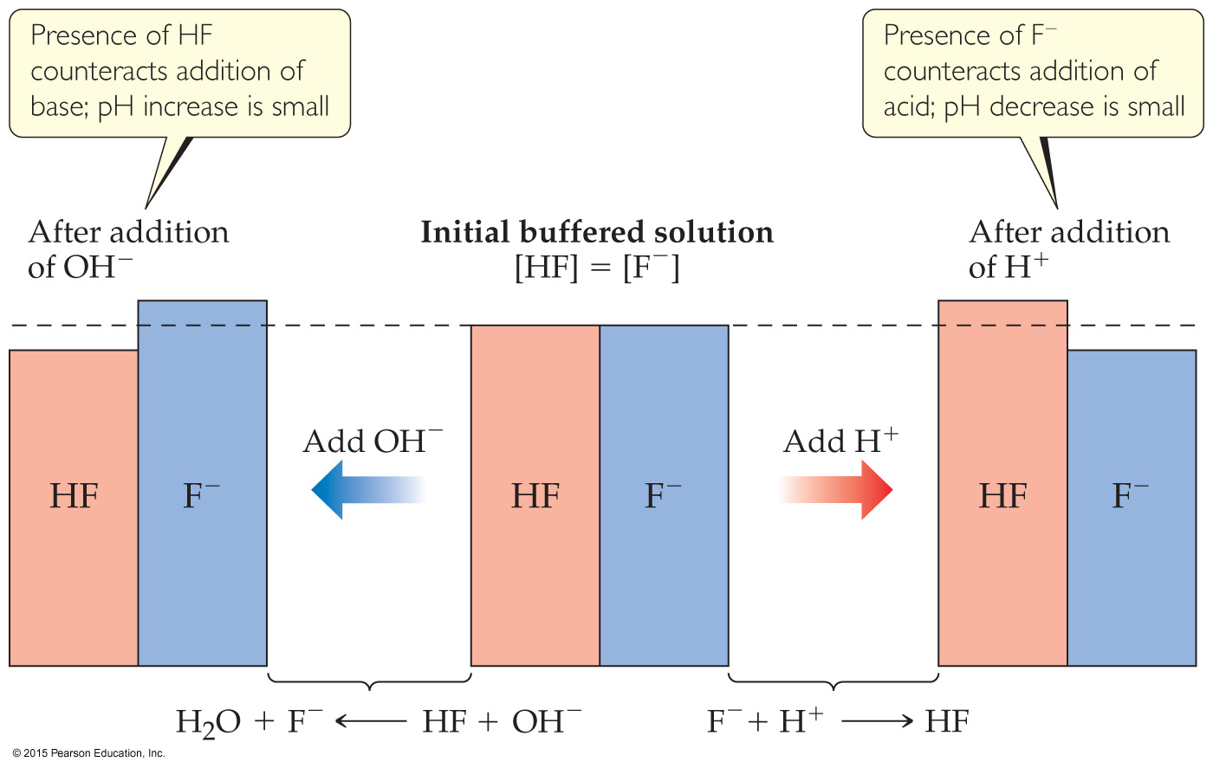
How a Buffer Works
Adding a small amount of acid or base only slightly neutralizes one component of the buffer, so the pH doesn’t change much.

Slide 11
Calculating the pH of a Buffer
For a weak acid: K_{a} = [H⁺][A–]/[HA]
Take –log of both sides:
–log K_{a} = –log[H⁺] + –log([A–]/[HA])
Rearrange:
–log[H⁺] = –log K_{a} +log([A–]/[HA])
Which is:
pH = pK_{a} + log([A–]/[HA])
This equation is known as the Henderson–Hasselbalch equation. This applies only to buffers.

Slide 12
Henderson–Hasselbalch Equation
What is the pH of a buffer that is 0.12 M in lactic acid, CH₃CH(OH)COOH, and 0.10 M in sodium lactate? K_{a} for lactic acid is 1.4 × 10⁻⁴.
pH = pK_{a} + log([A–]/[HA])
= –log(1.4 × 10^{–4}) + log[(0.10 M)/(0.12 M)]
= 3.85 + (–0.08) = 3.77

Slide 13
Buffer Capacity
The amount of acid or base the buffer can neutralize before the pH begins to change to an appreciable degree
Using the Henderson–Hasselbalch equation, pH will be the same for a conjugate acid–base pair of 1 M each or 0.1 M each; however, the buffer which is 1 M can neutralize more acid or base before the pH changes.

Slide 14
pH Range
The range of pH values over which a buffer system works effectively
Optimal pH: where pH = pK_{a}([HA] = [A–])
If one concentration is more than 10 times the other, the buffering action is poor; this means that the pH range of a buffer is usually ±1 pH unit from pK_{a}.
between (pK_{a} – 1) and (pK_{a} + 1)

Slide 15
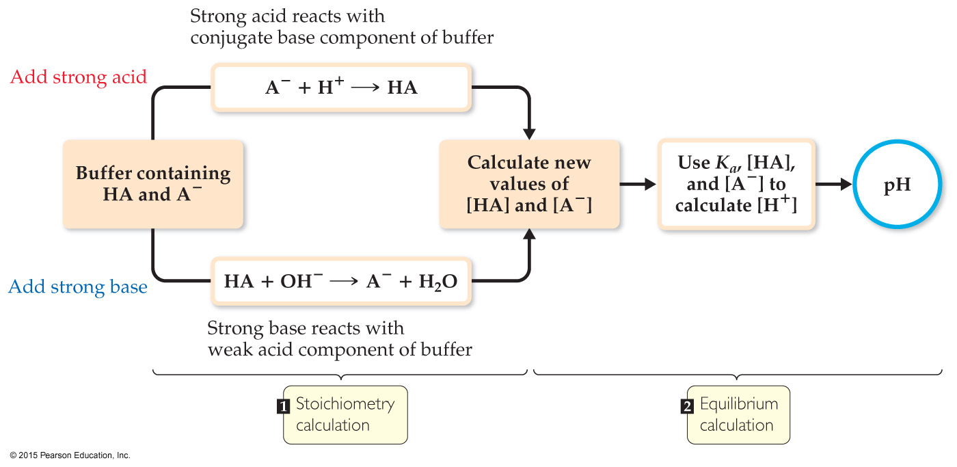
Addition of a Strong Acid or a Strong Base to a Buffer
Adding the strong acid or base is a neutralization reaction; calculate like stoichiometry problem to find [HA] and [A–] when all of the added acid or base reacts.
Use the Henderson–Hasselbalch equation to find pH.

Slide 16
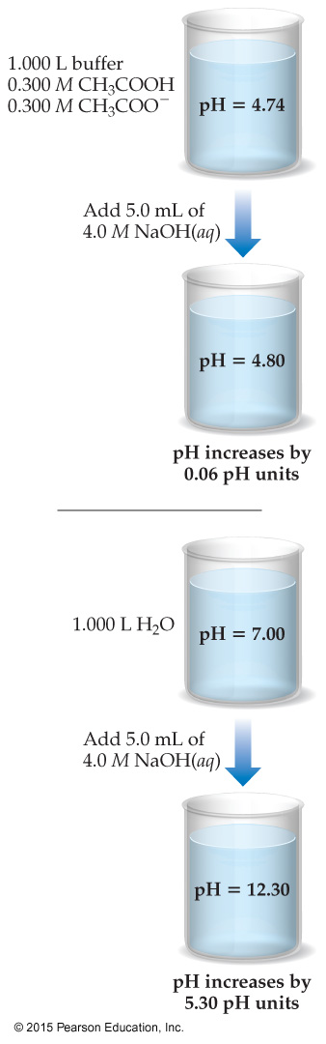
A buffer is made by adding 0.300 mol HC₂H₃O₂ and 0.300 mol NaC₂H₃O₂ to enough water to make 1.00 L of solution. Calculate the pH after 0.020 mol of NaOH is added.
 | [CH₃COOH] | [OH–] | [CH₃COO–]
Before reaction (mol) | 0.300 | 0.020 | 0.300
Change (mol) | –0.020 | –0.020 (LR) | +0.020
After reaction (mol) | 0.280 | 0 | 0.320

Slide 17
Use the Henderson–Hasselbalch equation:
pH = pK_{a} + log([A–]/[HA)
Since this is a buffer, the volume for each concentration is the same, so the ratio of molarity can be calculated using a ratio of moles.
pH = pK_{a} + log (n_{A}–/nHA)
pH = 4.74 + log(0.320/0.280) = 4.80

Slide 18
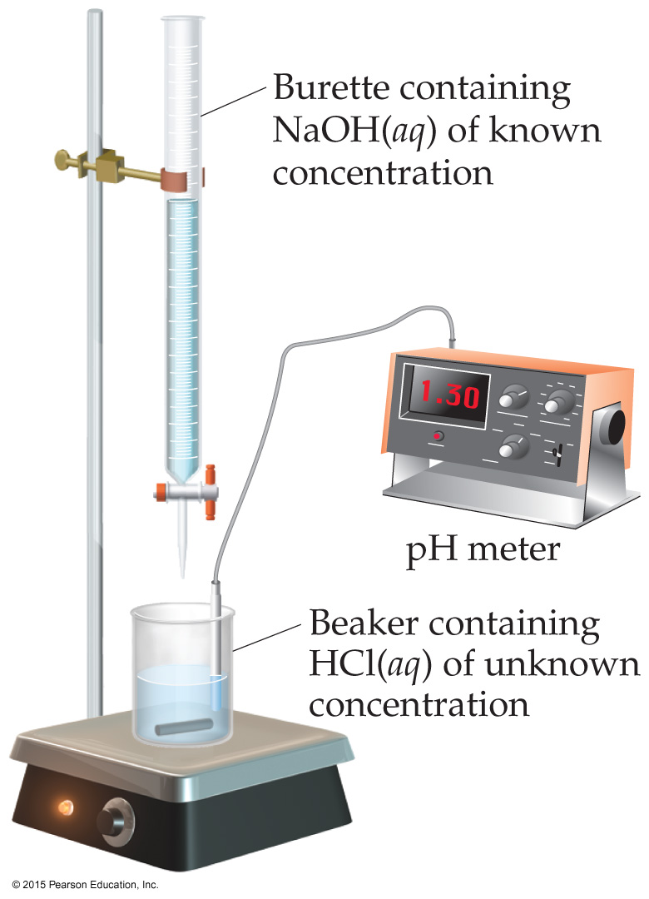
Titration
In this technique, an acid (or base) solution of known concentration is slowly added to a base (or acid) solution of unknown concentration.
A pH meter or indicators are used to determine when the solution has reached the equivalence point: The amount of acid equals that of base.

Slide 19
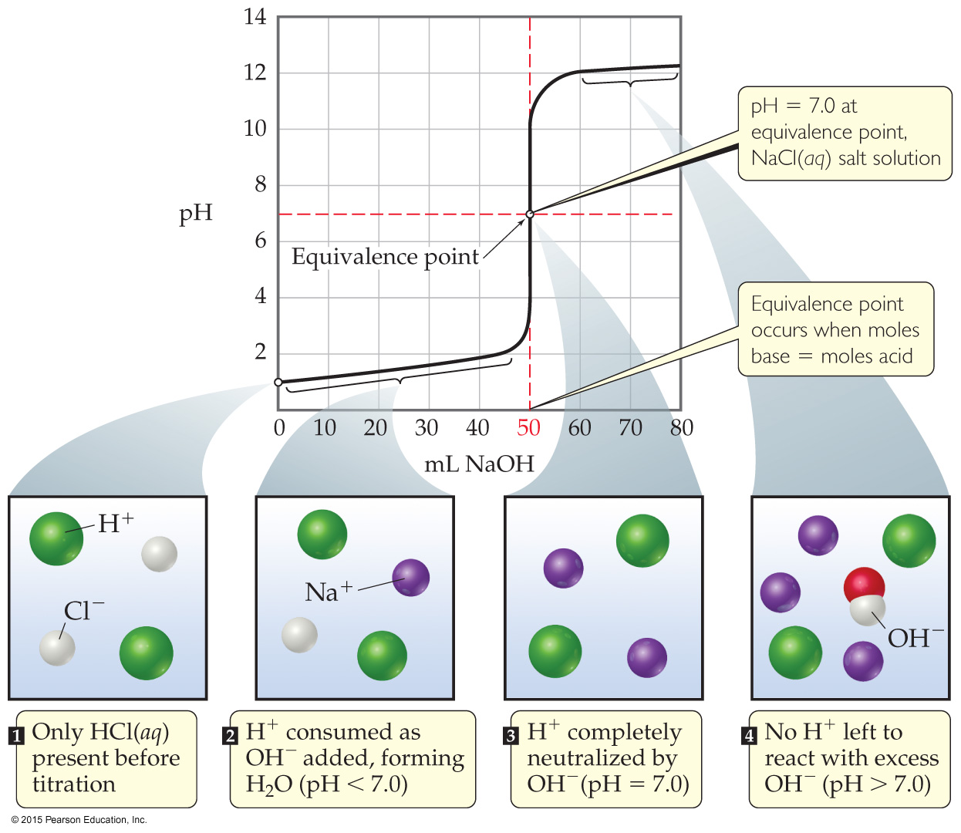
Titration of a Strong Acid with a Strong Base
From the start of the titration to near the equivalence point, the pH goes up slowly.
Just before (and after) the equivalence point, the pH rises rapidly.
At the equivalence point, pH = 7.
As more base is added, the pH again levels off.

Slide 20
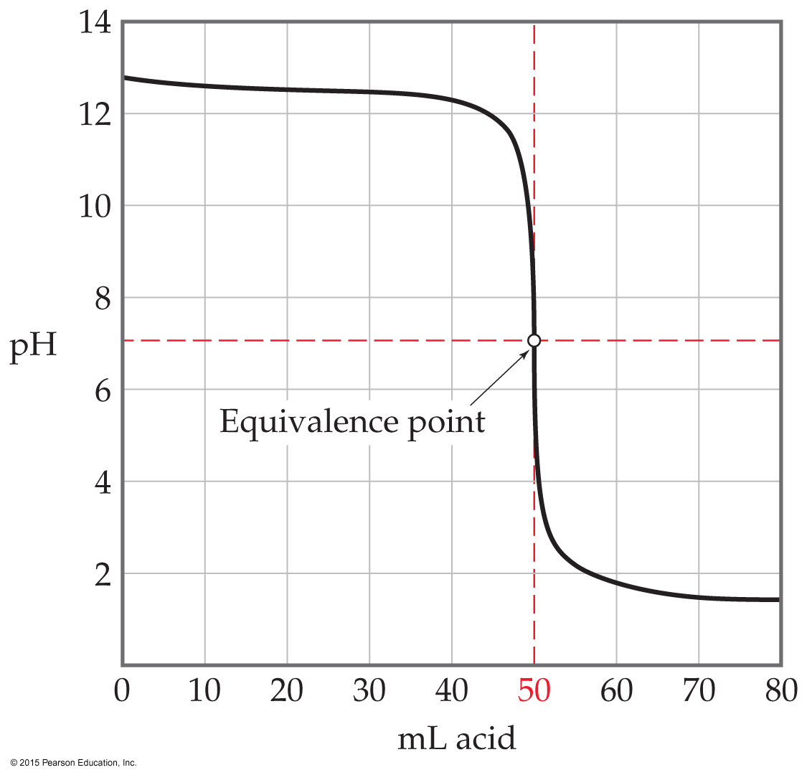
Titration of a Strong Base with a Strong Acid
It looks like you “flipped over” the strong acid being titrated by a strong base.
Start with a high pH (basic solution); the pH = 7 at the equivalence point; low pH to end.

Slide 21
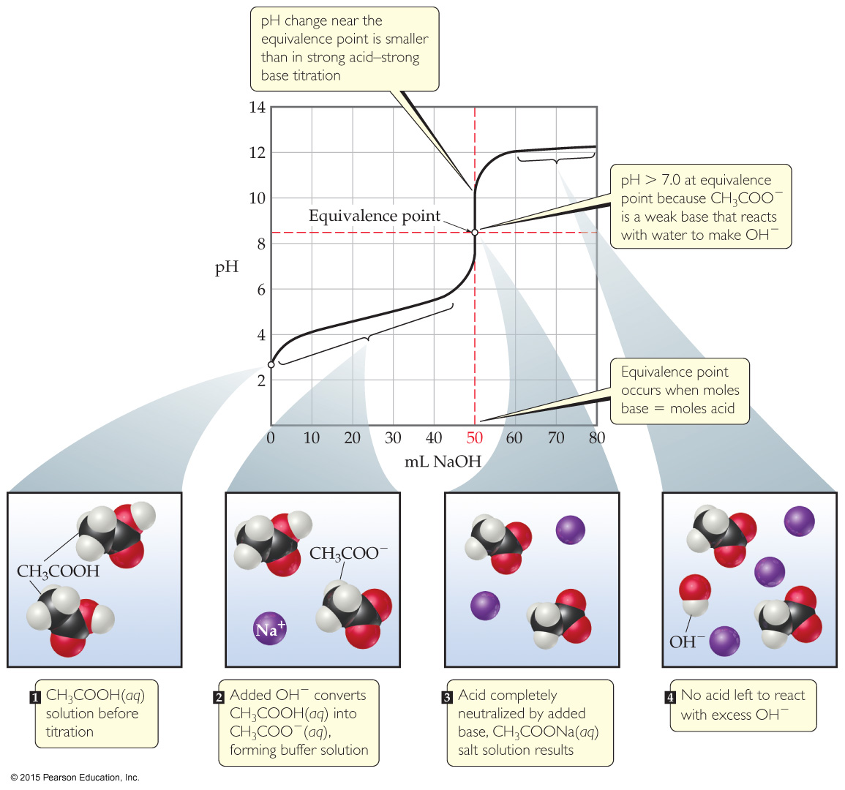
Titration of a Weak Acid with a Strong Base
Use K_{a} to find initial pH.
Find the pH in the “buffer region” using stoichiometry followed by the Henderson–Hasselbalch equation.
At the equivalence point the pH is >7. Use the conjugate base of the weak acid to determine the pH.
As more base is added, the pH levels off. This is exactly the same as for strong acids.

Slide 22
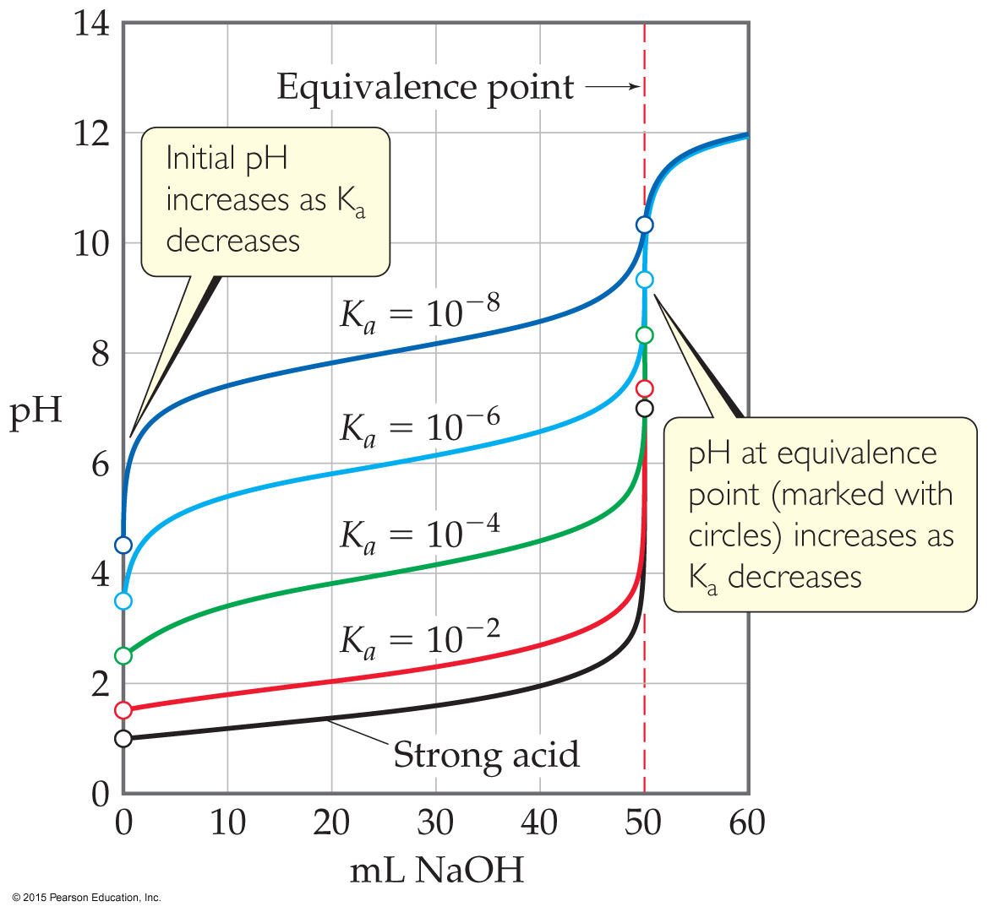
Ways That a Weak Acid Titration Differs from a Strong Acid Titration
A solution of weak acid has a higher initial pH than a strong acid.
The pH change near the equivalence point is smaller for a weak acid. (This is at least partly due to the buffer region.)
The pH at the equivalence point is greater than 7 for a weak acid.

Slide 23
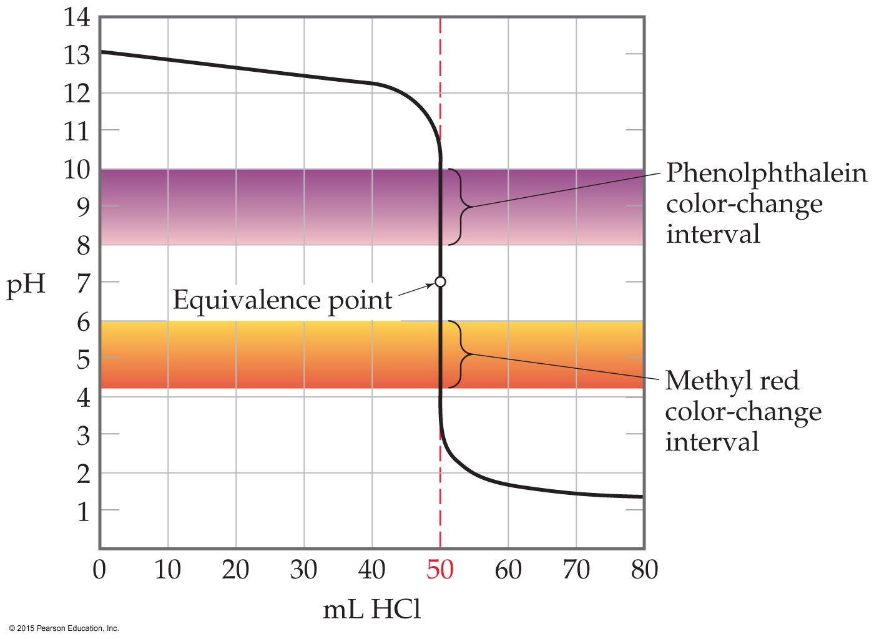
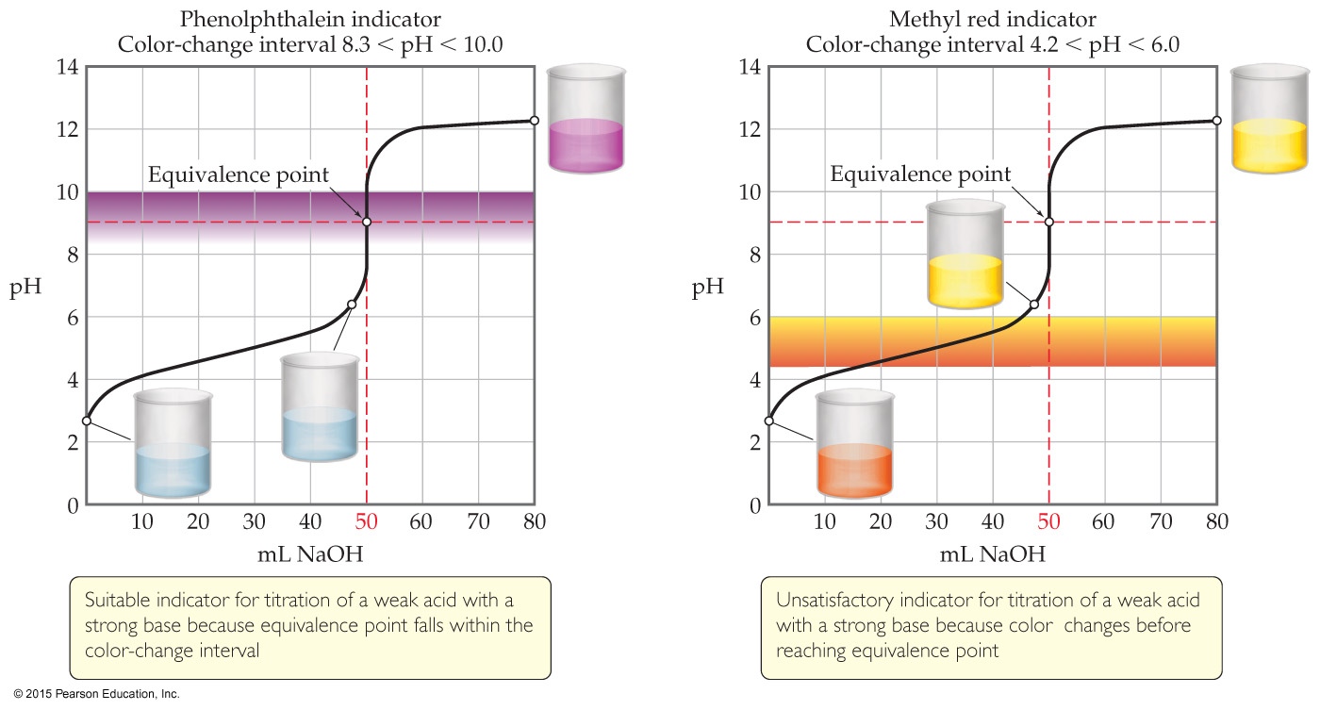
Use of Indicators
Indicators are weak acids that have a different color than their conjugate base form.
Each indicator has its own pH range over which it changes color.
An indicator can be used to find the equivalence point in a titration as long as it changes color in the small volume change region where the pH rapidly changes.

Slide 24
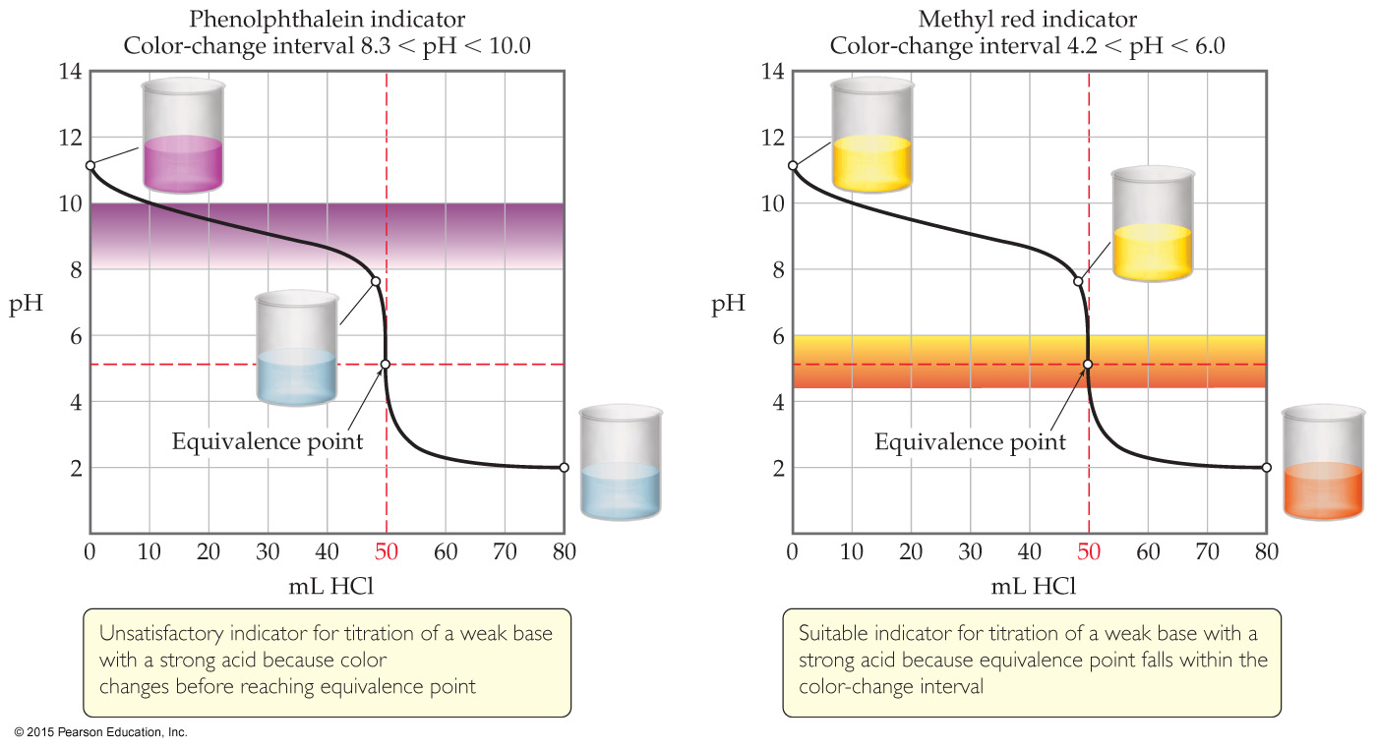
Indicator Choice Can Be Critical!

Slide 25
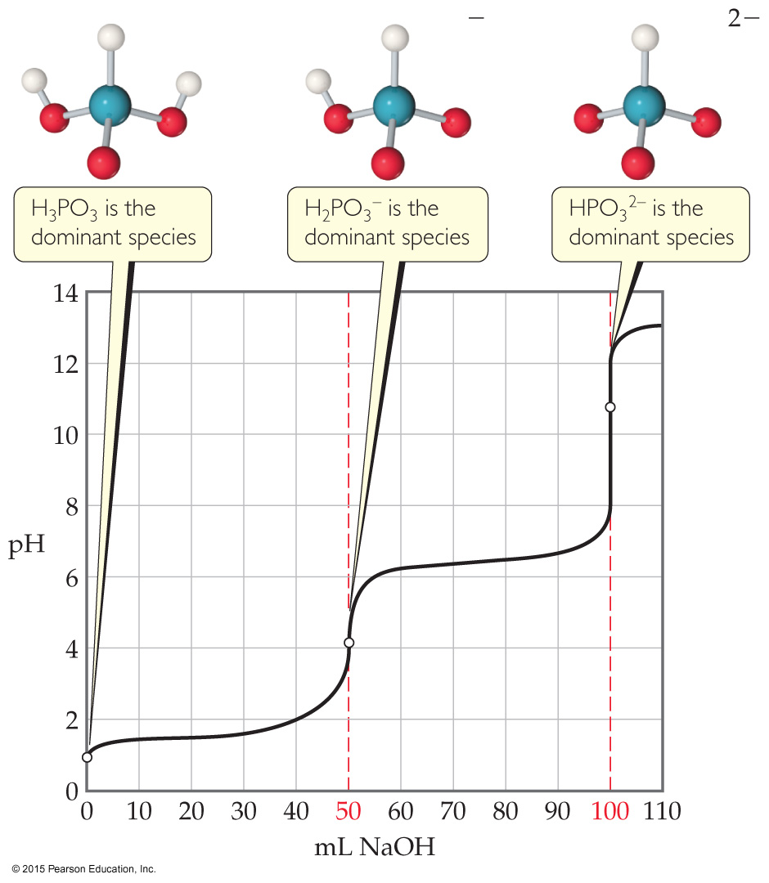
Titrations of Polyprotic Acids
When a polyprotic acid is titrated with a base, there is an equivalence point for each dissociation.
Using the Henderson–Hasselbalch equation, we can see that half way to each equivalence point gives us the pK_{a} for that step.

Slide 26
Solubility Equilibria
Because ionic compounds are strong electrolytes, they dissociate completely to the extent that they dissolve.
When an equilibrium equation is written, the solid is the reactant and the ions in solution are the products.
The equilibrium constant expression is called the solubility-product constant. It is represented as K_{sp}.

Slide 27
Solubility Product
For example:
BaSO₄(s) ⇌ Ba²⁺(aq) + SO₄^{2–}(aq)
The equilibrium constant expression is
K_{sp} = [Ba²⁺][SO₄²⁻]
Another example:
Ba₃(PO₄)₂(s) ⇌ 3 Ba²⁺(aq) + 2 PO₄^{3–}(aq)
The equilibrium constant expression is
K_{sp} = [Ba²⁺]³[PO₄³⁻]²

Slide 28
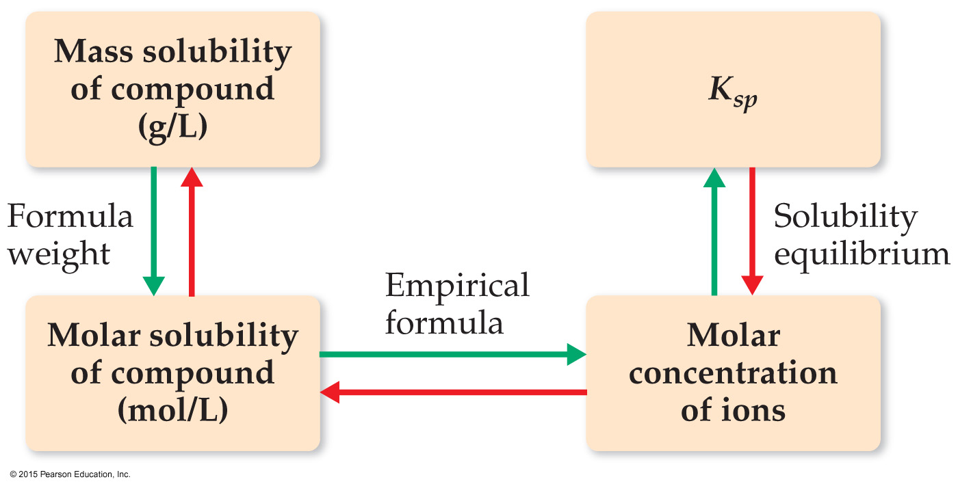
Solubility vs. Solubility Product
K_{sp} is not the same as solubility.
Solubility is the quantity of a substance that dissolves to form a saturated solution
Common units for solubility:
Grams per liter (g/L)
Moles per liter (mol/L)

Slide 29
Calculating Solubility from K_{sp}
The K_{sp} for CaF₂ is 3.9 × 10^{–11} at 25 °C. What is its molar solubility?
Follow the same format as before:
CaF₂(s) ⇌ Ca²⁺(aq) + 2 F–(aq)
K_{sp} = [Ca²⁺][F–]² = 3.9 × 10^{–11}
 | CaF₂(s) | [Ca²⁺](M) | [F–](M)
Initial concentration (M) | --- | 0 | 0
Change in concentration (M) | --- | +x | +2x
Equilibrium concentration (M) | --- | x | 2x

Slide 30
Example (completed)
Solve: Substitute the equilibrium concentration values from the table into the solubility-product equation:
3.9 × 10^{–11} = (x) (2x)² = 4x³
x = 2.1 × 10^{–4} M
(If you want the answer in g/L, multiply by molar mass; this would give 0.016 g/L.)

Slide 31
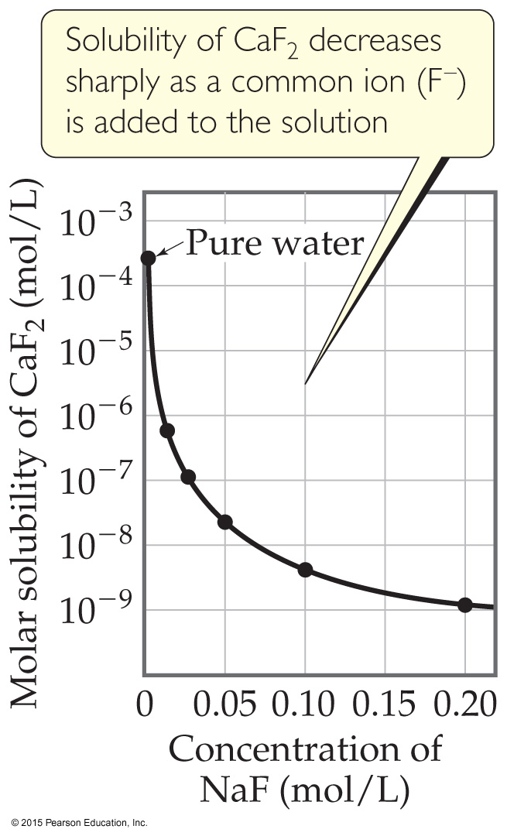
Factors Affecting Solubility
The Common-Ion Effect
If one of the ions in a solution equilibrium is already dissolved in the solution, the solubility of the salt will decrease.
If either calcium ions or fluoride ions are present, then calcium fluoride will be less soluble.

Slide 32
Calculating Solubility with a Common Ion
What is the molar solubility of CaF₂ in 0.010 M Ca(NO₃)₂?
Follow the same format as before:
CaF₂(s) ⇌ Ca²⁺(aq) + 2 F–(aq)
2) K_{sp} = [Ca²⁺][F–]² = 3.9 × 10^{–11}
3)
 | CaF₂(s) | [Ca²⁺](M) | [F–](M)
Initial concentration (M) | --- | 0.010 | 0
Change in concentration (M) | --- | +x | +2x
Equilibrium concentration (M) | --- | 0.010 + x | 2x

Slide 33
Example (completed)
Solve: Substitute the equilibrium concentration values from the table into the solubility-product equation:
3.9 × 10^{–11} = (0.010 + x)(2x)²
(We assume that x << 0.010, so that 0.010 + x = 0.010!)
3.9 × 10^{–11} = (0.010)(2x)²
x = 3.1 × 10^{–5} M

Slide 34
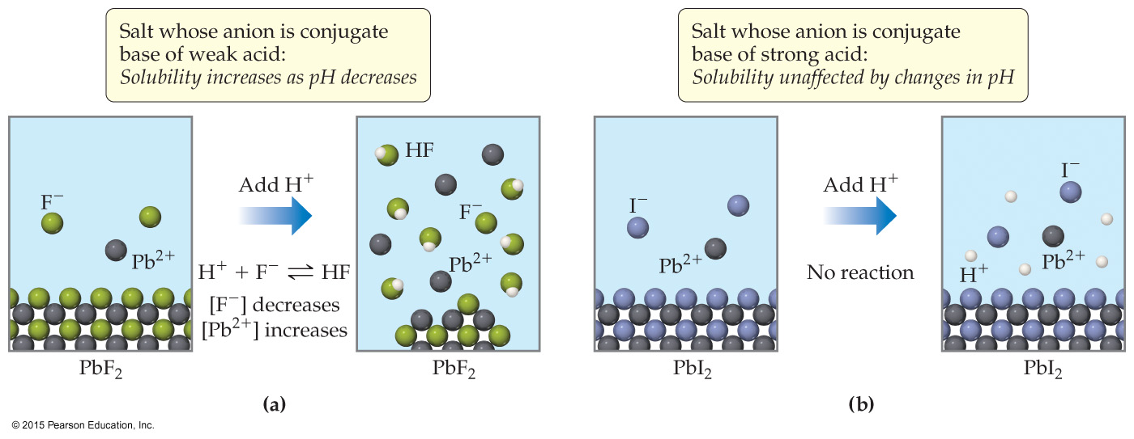
Factors Affecting Solubility
pH: If a substance has a basic anion, it will be more soluble in an acidic solution.
Remember that buffers control pH. When a buffer is used, there is no change in concentration of hydroxide ion!

Slide 35
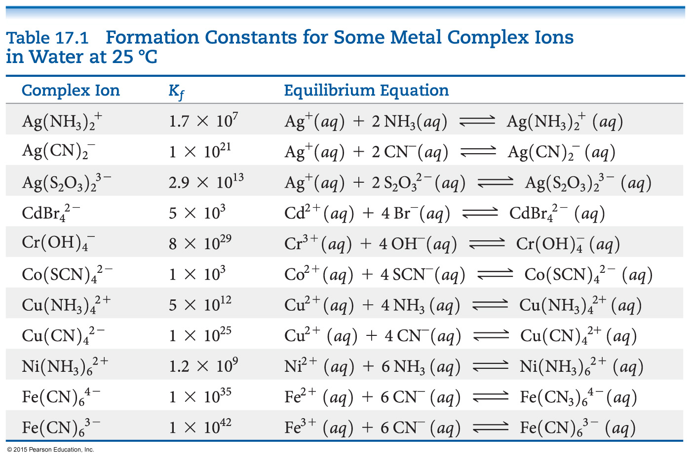
Complex Ion Formation
Metal ions can act as Lewis acids and form complex ions with Lewis bases in the solvent.
The formation of these complex ions increases the solubility of these salts.

Slide 36
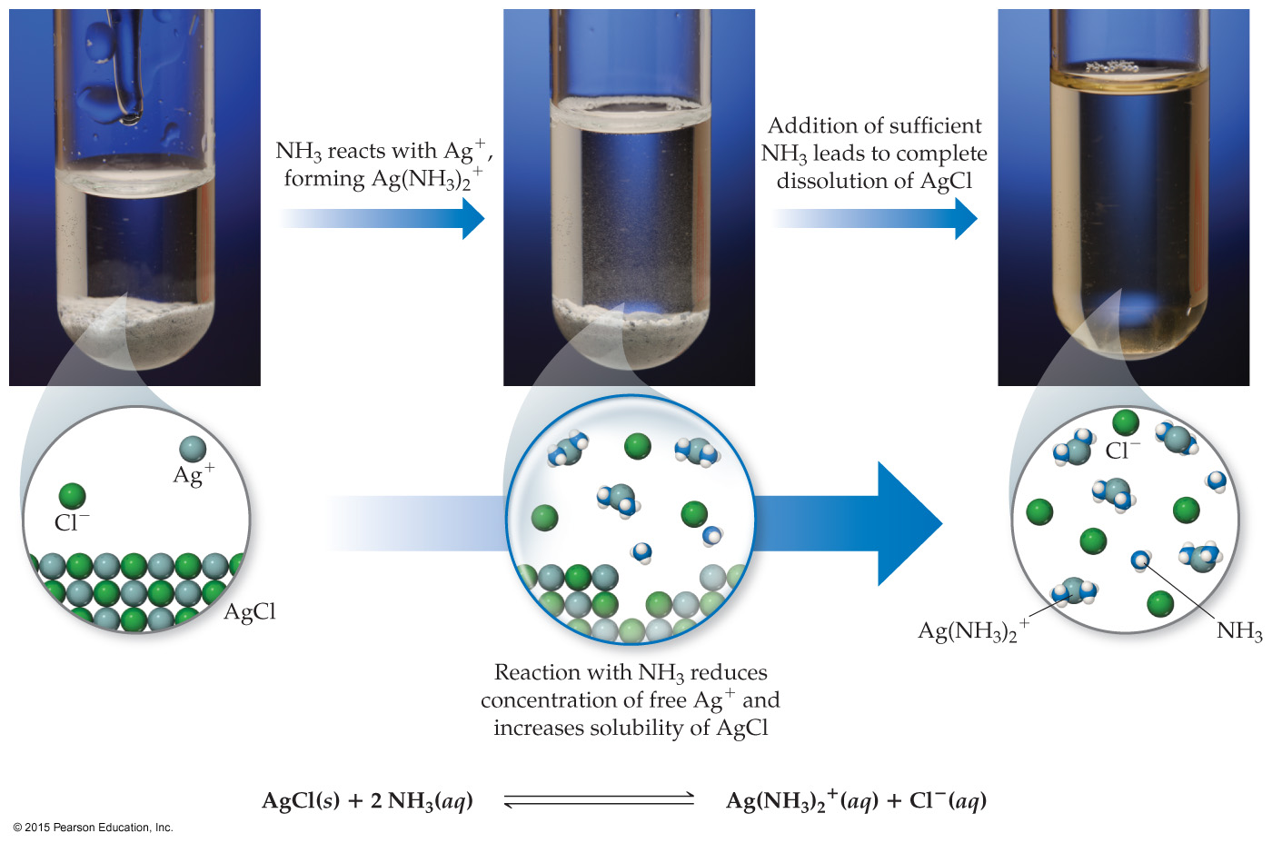
How Complex Ion Formation Affects Solubility
Silver chloride is insoluble. It has a K_{sp} of 1.6 × 10^{–10}.
In the presence of NH₃, the solubility greatly increases because Ag⁺ will form complex ions with NH₃.

Slide 37
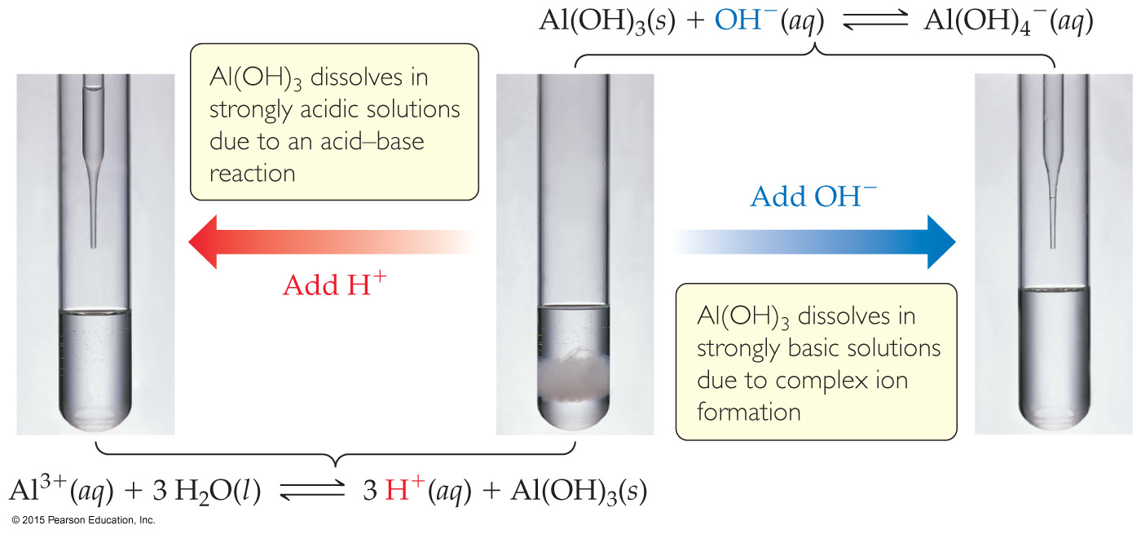
Amphoterism and Solubility
Amphoteric oxides and hydroxides are soluble in strong acids or base, because they can act either as acids or bases.
Examples are oxides and hydroxides of Al³⁺, Cr³⁺, Zn²⁺, and Sn²⁺.

Slide 38
Will a Precipitate Form?
To decide, we calculate the reaction quotient, Q, and compare it to the solubility product constant, K_{sp}.
If Q = K_{sp}, the system is at equilibrium and the solution is saturated.
If Q < K_{sp}, more solid can dissolve, so no precipitate forms.
If Q > K_{sp}, a precipitate will form.

Slide 39
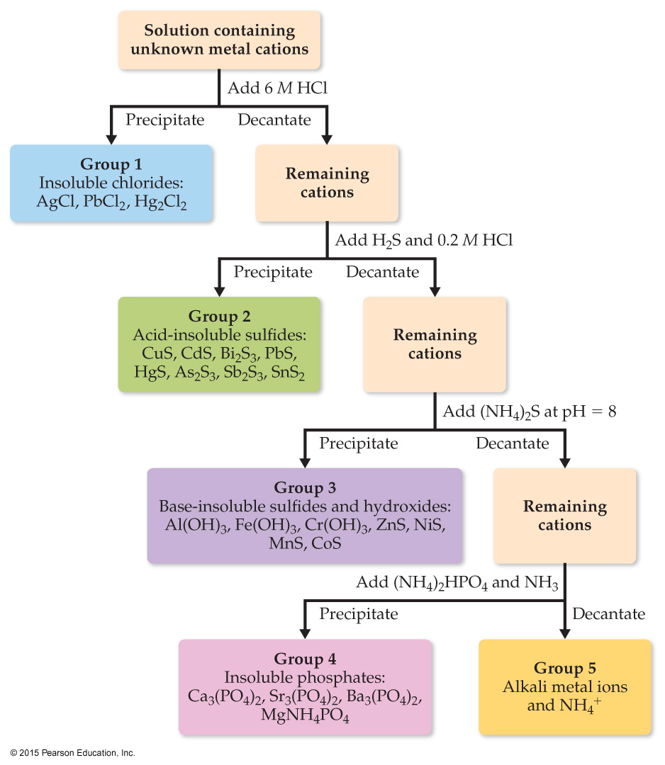
Selective Precipitation of Ions
One can use differences in solubilities of salts to separate ions in a mixture. This has been used for qualitative analysis of the presence of ions in a solution.

